Slide 1
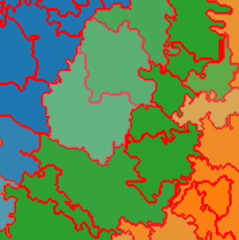
Compositional data on a map

Slide 2



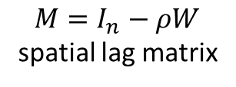
Adding a spatial lag term in a Dirichlet regression model
$$y_{i}∈R^{J}, α_{i}∈R^{J}$$
$$y_{i}∼ D\left(α_{i}\right), α_{ij}=φ_{i}μ_{ij}$$
$$μ_{ij}=softmax\left(M^{−1}Xβ\right),$$
$$M=I_{n}−ρW$$
spatial lag matrix

Slide 3
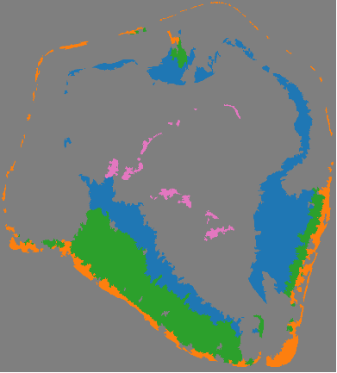

Final prediction
original
map
predicted map
(no spatial)
predicted map
(with spatial)

